Slide 1
SRI RAMAKRISHNA ENGINEERING COLLEGE
[Educational Service : SNR Sons Charitable Trust]
[Autonomous Institution, Reaccredited by NAAC with ‘A+’ Grade]
[Approved by AICTE and Permanently Affiliated to Anna University, Chennai]
[ISO 9001-2015 Certified and all eligible programmes Accredited by NBA]
VATTAMALAIPALAYAM, N.G.G.O. COLONY POST, COIMBATORE – 641 022.
Department of Electronics and Communication Engineering
20EC214 & DIGITAL CMOS VLSI CIRCUITS
Course Instructor:
Mr.R.Chandru,
Assistant Professor(Sl.G)/ECE
No. of Credits : 3

Slide 2
20EC214 - DIGITAL CMOS VLSI CIRCUITS COURSE OUTCOMES
On successful completion of the course, students will be able to,
COURSE OUTCOMES
CO₁ | Interpret the characteristics and manufacturing process technologyof MOS transistor.
CO₂ | Analyze the various logic styles of CMOS combinational andsequential circuits
CO₃ | Design the various digital arithmetic logic circuits.
CO₄ | Illustrate the performance of the digital circuits by examining the timing issues.
CO₅ | Make use of MOS concepts in construction of Memory Array Subsystem.

Slide 3
20EC214 - DIGITAL CMOS VLSI CIRCUITS COURSE CONTENTS
PREREQUISITES
20EC204 - Digital System Design
MOS TRANSISTOR AND PROCESSING 10
MOSFET theory - Transistor switches - Compound gates - Design equations - IV characteristics - CV characteristics - Second order effects - Energy and Power - Resistance Estimation - Capacitance Estimation - Switching Characteristics - RC Delay Models - Logical Effort for gates - CMOS Process technology - Design Rules and Layout.
CMOS LOGIC STRUCTURES 11
Combinational Circuits: CMOS Inverter - DC Characteristics - Complementary Logic Structures - Ratioed logic - Pass transistor logic - Transmission gate - Tristate Inverter - Multiplexers - Dynamic logic structures. Sequential Circuits: Static latches and Registers, Dynamic latches and Registers, Pulse Registers, Sense Amplifier Based Register, Pipelining.
DESIGN OF ARITHMETIC BUILDING BLOCKS 8
Full adder, Ripple carry adder, Carry bypass adder, Linear and Square root carry-select adder, Carry look-ahead adder - Multipliers - Barrel and logarithmic shifter.
TIMING ISSUES 8
Timing Basics, Sources of Skew and Jitter, Clock-Distribution Techniques, Latch-Based locking, Self-Timed Circuit Design, Synchronizers and Arbiters, Clock Synthesis and Synchronization Using a Phase-Locked Loop.
MEMORY ARRAY SUBSYSTEM 8
SRAM: SRAM Cells, Row Circuitry, Column Circuitry. Multiported SRAM and Register files DRAM: Subarray Architectures, Column Circuitry, Embedded DRAM. Read-Only Memory: Programmable ROMs, NAND ROMs, Flash.

Slide 4
20EC214 - DIGITAL CMOS VLSI CIRCUITS COURSE CONTENTS
TEXT BOOKS
Neil H.E. Weste and David Harris, "CMOS VLSI Design A Circuits and Systems Perspective", 4th Edition, Pearson Education, Reprint 2010.
Jan M. Rabaey, Anantha Chandrakasan and B Nikolic, "Digital Integrated Circuits: A Design Perspective", 2nd Edition, Pearson Education India, 2016.
REFERENCES
Douglas. A. Pucknell, Kamran Eshraghian, "Basic VLSI Design", 3rd Edition, Prentice Hall India, 2010.
John P.Uyemura, "Introduction to VLSI Circuits and Systems", John Wiley & Sons, 2012.
WEB REFERENCES
https://nptel.ac.in/courses/108/107/108107129/
https://nptel.ac.in/courses/117/106/117106093/

Slide 5
MODULE 4 TIMING ISSUES
□ Timing Basics
□ Sources of Delay in CMOS Circuits
□ Propagation Delay and Contamination Delay
□ Rise Time and Fall Time
□ Clock Skew and Jitter
□ Sources of Clock Skew
□ Clock Distribution Techniques
□ Latch-Based Clocking
□ Edge Triggered Flip-Flops
□ Timing Constraints: Setup Time and Hold Time
□ Self-Timed Circuit Design
□ Synchronizers and Arbiters
□ Metastability
□ Clock Synthesis
□ Phase-Locked Loop (PLL)
□ Clock Synchronization Techniques

Slide 6
MODULE 2
Understanding Clock Skew
The Need for a Clock
A clock signal controls when operations happen in the circuit.
Synchronous systems use a clock to sequence operations.
The clock distinguishes one step in a computation from the next.
Ideal Goal: The clock arrives at all clocked elements (flip-flops, latches, memory) at the exact same time.
This creates a common, universal time reference for the entire chip.

Slide 7
MODULE 2
Understanding Clock Skew
The Ideal vs. The Reality
A clock signal controls when operations happen in the circuit.
The Problem: In practice, the clock signal doesn't arrive everywhere at once.
Variations in wire length, manufacturing, temperature, and voltage cause different arrival times.
Definition: This difference in arrival time is called Clock Skew.
• In an ideal system, the clock should arrive at all flip-flops at exactly the same time.
• This ensures perfect synchronization.
• Ideal condition:
Clock arrival time at all elements = same
• No timing mismatch between circuit components.
• This assumption is often used during initial design and modeling.

Slide 8
MODULE 2
Understanding Clock Skew
Clock Skew
In practice, the clock signal does not arrive everywhere at the same time.
• The clock travels through:
long wires
buffers
clock trees
routing paths
• These introduce propagation delays.
• Due to this, different flip-flops receive the clock at slightly different times.
• This timing difference is called Clock Skew.
• Clock Skew is the difference in arrival time of the same clock signal at different clocked elements.
Clock Skew=tarrival2−tarrival1
​ • If one flip-flop receives the clock earlier than another, skew occurs.
• Clock skew is usually measured in:
picoseconds (ps)
nanoseconds (ns)
• Even very small skew can affect high-speed circuits.

Slide 9
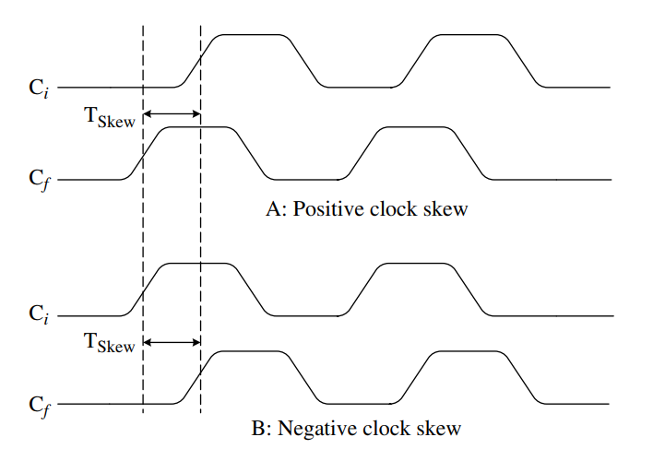
MODULE 2
Understanding Clock Skew
Clock timing diagrams
The Cf rising edge happens first Then Ci rising edge happens later.
Cf ↑ first
Ci ↑ later
The clock reaches R2 earlier than R1

Slide 10
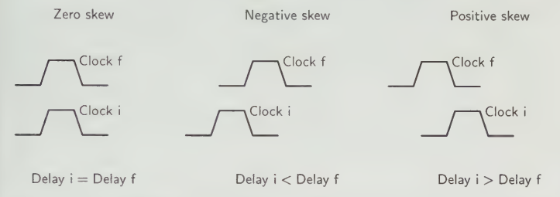
MODULE 2
Understanding Clock Skew

Slide 11
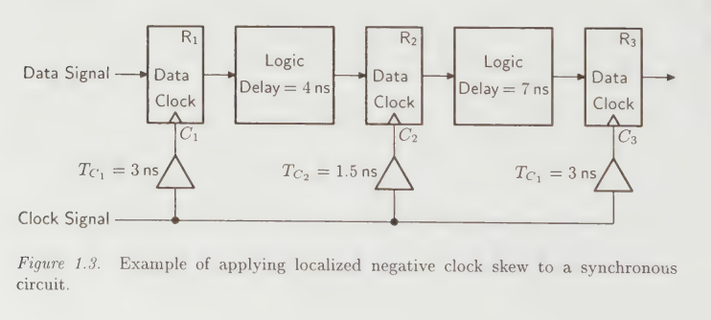
MODULE 2
Understanding Clock Skew

Slide 12
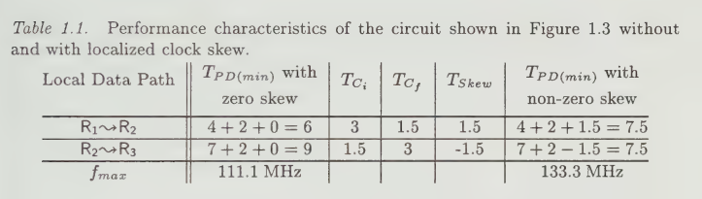
MODULE 2
Understanding Clock Skew

Slide 13
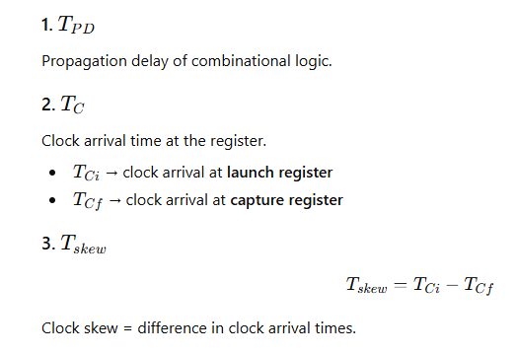

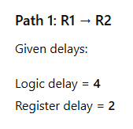



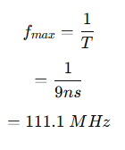

MODULE 2
Understanding Clock Skew
Performance Improvement Using Localized Clock Skew
Case 1: Zero Clock Skew
Without clock skew → 111.1 MHz

Slide 14

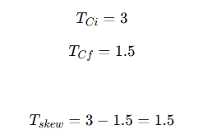
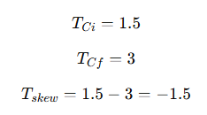
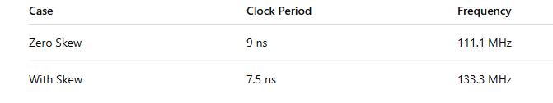


MODULE 2
Understanding Clock Skew
Case 2: With Localized Clock Skew
Path 1
Path 2
New delay
New delay
Clock skew is usually considered bad, but here intentional skew improved performance.
This technique is called: Useful Clock Skew
It balances delays between pipeline stages.
By intentionally adjusting clock arrival times, the critical path delay is reduced, increasing the maximum clock frequency.

Slide 15


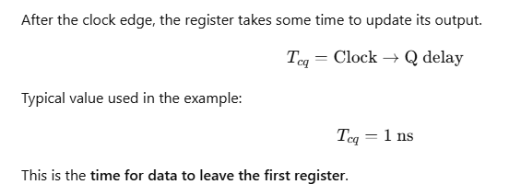

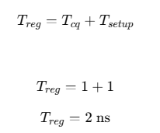
MODULE 2
Understanding Clock Skew
Setup Time (Tsetup)
Total Register Delay
Register delay is the sum of clock-to-Q delay of the launching flip-flop and setup time of the capturing flip-flop

Slide 16
MODULE 2
Understanding Clock Skew
Sources of Skew and Jitter
Unequal Clock Path Length (Source of Skew)
Clock Distribution Problems in VLSI
Clock signals in large VLSI chips do not reach all registers at the same time. Two major timing problems occur:
Clock Skew
Difference in clock arrival time at different registers.
Clock Jitter
Variation of the clock edge timing from its ideal position.
The clock signal travels through metal wires from the clock source to different registers.
If the wire lengths are different:
Some registers receive the clock earlier
Some registers receive the clock later
Reason
Longer wires have:
Higher resistance
Higher capacitance
This increases propagation delay.
Result
Different arrival times of the clock signal create clock skew.

Slide 17
MODULE 2
Understanding Clock Skew
Buffer / Driver Delay Variation (Source of Skew)
Process Variation (Source of Skew)
Explanation
Clock networks use buffers and drivers to distribute the clock signal across the chip.
Each buffer introduces a small delay.
Problem
Different paths may contain:
Different number of buffers
Different buffer sizes
Result
Some clock paths become slower than others, producing clock skew.
Explanation
During semiconductor fabrication, small variations occur in:
Transistor dimensions
Oxide thickness
Doping concentration
Effect
These variations change:
Transistor switching speed
Gate delay
Result
Clock signals propagate with different delays in different chip regions, causing skew.

Slide 18
MODULE 2
Understanding Clock Skew
Temperature Variation (Source of Skew)
Power Supply Variation (Source of Skew)
Explanation
Different areas of a chip operate at different temperatures.
Example:
ALU area may become hotter
Memory area may remain cooler
Effect
Higher temperature causes:
Increased resistance
Slower transistor switching
Result
Clock signal delay changes, producing clock skew.
Explanation
The supply voltage may not be uniform across the chip.
Voltage drops may occur due to:
IR drop
Heavy current consumption
Effect
Lower voltage causes:
Slower transistor switching
Increased gate delay
Result
Clock signals reach registers at different times → clock skew.

Slide 19
MODULE 2
Understanding Clock Skew
Power Supply Noise (Source of Jitter)
Crosstalk (Source of Jitter)
Explanation
Noise in the power supply causes small fluctuations in voltage.
Effect
These fluctuations change transistor switching speed continuously.
Result
The clock edge does not occur at a fixed time every cycle.
This produces clock jitter.
Explanation
Adjacent signal wires can interfere with the clock line.
When nearby signals switch, they induce electromagnetic coupling.
Effect
This temporarily changes the voltage on the clock line.
Result
The clock edge shifts slightly forward or backward, creating jitter.

Slide 20
MODULE 2
Understanding Clock Skew
PLL/DLL Instability (Source of Jitter)
Explanation
Clock signals are often generated using:
PLL (Phase Locked Loop)
DLL (Delay Locked Loop)
Problem
If the PLL loop is unstable or noisy:
Phase fluctuations occur
Frequency variations occur
Result
Clock edges move randomly → clock jitter.

Slide 21
MODULE 2
Interconnect Methodologies
When two modules communicate in a digital system, the relationship between their clocks determines the communication method.
Four major types of interconnects:
Synchronous
Mesochronous
Plesiochronous
Asynchronous
These interconnect types differ based on:
Clock frequency
Clock phase relationship

Slide 22
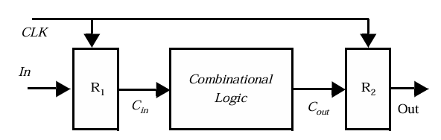
MODULE 2
Synchronous Interconnect
In a synchronous interconnect, all modules use the same clock signal.
Characteristics:
Same clock frequency
Same clock phase
Registers operate with the same clock edge
Operation:
Data is stored in R1 at a clock edge.
Data travels through combinational logic.
On the next clock edge, R2 captures the data.
Advantages
Simple design
Easy timing analysis
Most common in digital systems
Synchronous interconnect methodology
In synchronous systems, every register uses the same clock. Because the clock edges are perfectly aligned, the receiver knows exactly when to sample the data.

Slide 23
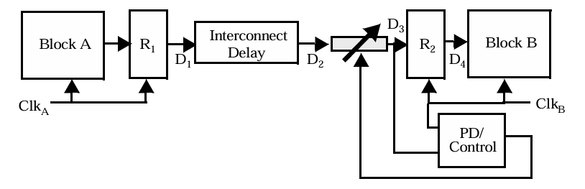
MODULE 2
Mesochronous Interconnect
In a mesochronous system:
Clock frequencies are same
Phase difference between clocks is unknown
Example:
Two chips both operate at 100 MHz, but their clock edges are shifted in time.
Problem:
The receiver does not know exactly when the data arrives.
Solution:
A variable delay circuit is used to align the data with the receiving clock.
Main components:
Transmitting register
Interconnect delay
Variable delay element
Phase detector control
Receiving register
In mesochronous systems, both modules run at the same frequency, but their clock edges are not aligned. Because of this phase difference, we adjust the data timing using a delay circuit before capturing it.

Slide 24
MODULE 2
Mesochronous Interconnect
Role of the Variable Delay Circuit
In a mesochronous system, the transmitting and receiving clocks have the same frequency, but the phase difference between them is unknown. Because of this, the receiver may not know the exact time when data arrives.
How it Works
Data from the transmitter passes through the interconnect path.
A phase detector compares the data timing with the receiving clock.
The variable delay line adjusts the data timing.
Data is shifted forward or backward in time until it aligns with the receiving clock.
The receiving register then captures the data safely.
Purpose of the Variable Delay Circuit
Adjusts the arrival time of the data signal.
Aligns the data signal with the receiving clock.
Ensures the receiver samples the data during the stable period.
Prevents sampling errors and metastability.
The variable delay circuit shifts the data signal in time so that it arrives exactly when the receiving clock samples it.

Slide 25
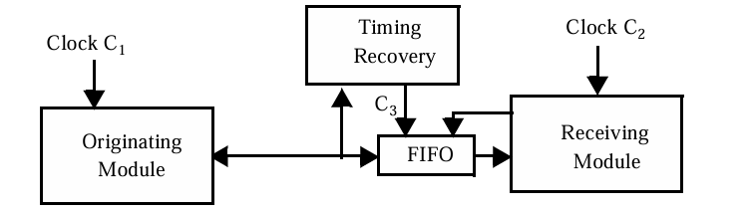
MODULE 2
Plesiochronous Interconnect
In plesiochronous communication:
Clock frequencies are almost the same
But not exactly equal
Example:
Sender clock = 100 MHz
Receiver clock = 100.01 MHz
Because of this small difference, the clocks drift apart over time.
This means:
Sometimes data arrives faster than the receiver reads it
Sometimes data arrives slower than the receiver reads it
This can cause data loss or errors.
Solution:
A FIFO buffer is used to absorb timing differences.
System components:
Originating module
Timing recovery unit
FIFO buffer
Receiving module

Slide 26
MODULE 2
Plesiochronous Interconnect
FIFO Buffer
To handle this timing difference, we use a FIFO (First-In First-Out) buffer.
A FIFO is a temporary storage memory placed between the sender and receiver
The sender writes data into the FIFO using its own clock.
The receiver reads data from the FIFO using its own clock.
The FIFO stores incoming data temporarily.
If the sender is faster, the FIFO stores extra data.
If the receiver is faster, it reads data already stored in the FIFO.
The FIFO absorbs the small timing differences between the two clocks.
This allows reliable communication even though the clocks are not perfectly matched.
A FIFO buffer temporarily stores incoming data so that differences between the sending and receiving clock speeds do not cause data loss.

Slide 27
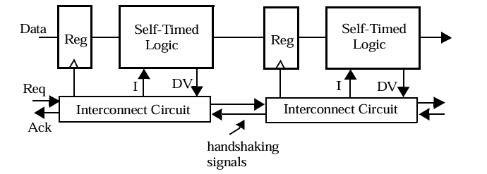
MODULE 2
Asynchronous Interconnect
In asynchronous systems:
There is no global clock
Data transfer occurs using handshake signals
Two signals control communication:
Req (Request) – sender requests data transfer
Ack (Acknowledge) – receiver confirms data reception
Operation:
Sender places data on the bus
Sender sends Req signal
Receiver reads the data
Receiver sends Ack signal
Sender sends the next data
Advantages
No clock distribution required
Useful for communication between independent systems
In asynchronous systems, there is no shared clock. Instead, communication happens using request and acknowledge signals. Data is transferred only when both sender and receiver agree.

Slide 28
MODULE 2
Sources of Skew and Jitter
Clock Generation (Source of Jitter)
The Source
The clock signal in a digital system is generated by a clock generator circuit, typically a Voltage-Controlled Oscillator (VCO) inside a Phase-Locked Loop (PLL).
A low-frequency reference clock is provided.
The PLL multiplies it to produce a high-frequency system clock.
The Problem
The clock generator is an analog circuit operating in a noisy digital environment.
Several noise sources affect the oscillator:
Substrate Noise Switching activity in nearby digital circuits injects noise into the silicon substrate. This noise couples into the sensitive VCO and disturbs its oscillation frequency.
Device Noise Transistors inside the oscillator generate thermal noise and flicker noise.
Power Supply Noise Variations in supply voltage affect the oscillator frequency.
Because of these disturbances, the oscillator frequency slightly fluctuates.

Slide 29
MODULE 2
Sources of Skew and Jitter
Clock Generation (Source of Jitter)
Impact
Since the starting point of the clock signal is unstable, each clock period is slightly different.
This causes cycle-to-cycle variations in the clock period, which is known as clock jitter.
The generated jitter then propagates through the entire clock distribution network, affecting all registers in the system.
Clock jitter can originate from the clock generator itself, because noise in the VCO or PLL causes small variations in the clock period.

Slide 30
MODULE 2
Sources of Skew and Jitter
Manufacturing Device Variations (Source of Skew)
The Source
Clock distribution networks use buffers and drivers to distribute the clock signal across the chip.
The Problem
Due to manufacturing process variations, the electrical parameters of devices differ slightly across the chip.
Examples include:
Oxide thickness variation → affects transistor gain and threshold voltage
Dopant concentration variation → changes device characteristics
Channel length variation → affects switching speed
Parasitic capacitance variation → changes delay of buffers
Because of these variations, buffers along different clock paths do not behave identically.
Impact
Some clock paths become faster while others become slower, causing the clock to arrive at registers at different times

Slide 31
MODULE 2
Sources of Skew and Jitter
Interconnect Variations (Source of Skew)
The Source
Clock signals travel through metal interconnect wires across the chip.
The Problem
Fabrication variations cause changes in:
Wire width
Wire spacing
Inter-layer dielectric (ILD) thickness
Metal layer thickness
These variations change the resistance (R) and capacitance (C) of the wires.
Since the delay of a wire depends on its RC value, different clock paths experience different propagation delays.
Impact
Clock signals reach different registers at different times, producing clock skew.

Slide 32
MODULE 2
Sources of Skew and Jitter
Power Supply Variations (Source of Jitter)
The Source
Clock buffers and drivers operate using the power supply voltage (VDD).
The Problem
Power supply voltage is not perfectly constant because of:
switching activity in digital circuits
IR drops in the power grid
inductive noise in power lines
These fluctuations cause the transistor switching speed to change dynamically.
Impact
Buffer delays vary from cycle to cycle, which changes the timing of clock edges.
This results in clock jitter.

Slide 33
MODULE 2
Sources of Skew and Jitter
Temperature Variations (Source of Skew)
The Source
Different regions of the chip operate at different temperatures.
The Problem
Temperature strongly affects transistor parameters such as:
threshold voltage
carrier mobility
switching speed
For example:
Active logic regions become hotter
Idle regions remain cooler
Thus, clock buffers located in different areas experience different delays.
Impact
Clock signals arrive at registers at different times, creating clock skew.

Slide 34
MODULE 2
Sources of Skew and Jitter
Capacitive Load Variations (Source of Skew)
The Source
Each clock buffer drives a capacitive load, which includes:
interconnect capacitance
gate capacitance of registers
latch inputs
The Problem
Different clock paths may drive different numbers of registers or gates, causing variation in load capacitance.
Since buffer delay depends on the load it drives, different loads cause different delays.
Impact
Clock signals propagate through paths at different speeds, producing clock skew.

Slide 35
MODULE 2
Sources of Skew and Jitter
Coupling to Adjacent Lines (Source of Jitter)
The Source
Clock wires run close to other signal wires on the chip.
The Problem
Switching activity on neighboring wires causes capacitive coupling.
Since nearby signals switch randomly, the coupling noise injected into the clock line changes continuously.
Impact
The clock signal experiences timing variations from cycle to cycle, resulting in clock jitter.

Slide 36
MODULE 2
Sources of Skew and Jitter
Source | Main Cause | Result
Clock generation noise | VCO / PLL instability | Jitter
Device variations | transistor mismatch | Skew
Interconnect variations | RC delay differences | Skew
Power supply noise | VDD fluctuation | Jitter
Temperature variation | mobility & threshold change | Skew
Capacitive load variation | different loads | Skew
Coupling with nearby wires | switching interference | Jitter

Slide 37
MODULE 2
Clock-Distribution Techniques
Why Clock Distribution is Important
In digital systems, the clock signal must reach all registers.
However, two major problems occur:
Clock Skew → clock arrives at different times at different registers
Clock Jitter → clock edge timing varies from cycle to cycle
Therefore, designers must design a clock distribution network that:
minimizes skew
minimizes jitter
reduces power consumption
Another important factor is clock gating, which shuts down unused parts of the clock network to save power.
But clock gating can introduce extra clock uncertainty.

Slide 38
MODULE 2
Clock-Distribution Techniques
Clock Distribution Network Concept
A clock is generated at a central source and distributed across the chip.
Important idea:
The absolute delay from the clock source is not important. What matters is that all registers receive the clock at the same time.
Even if the clock takes several cycles to travel, it is acceptable as long as the arrival times are equal.
To achieve this, designers use balanced clock paths.

Slide 39
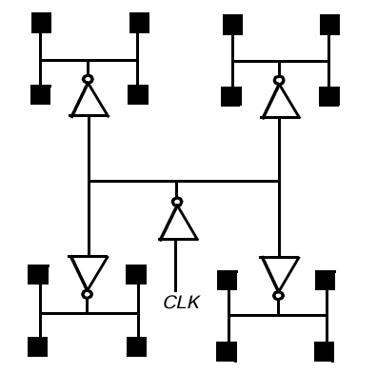
MODULE 2
Clock-Distribution Techniques
H-Tree Clock Distribution
Example of an H-tree clock-distribution network for 16 leaf nodes
The H-tree structure distributes the clock symmetrically across the chip.
It looks like the letter H repeated multiple times.
Clock signal starts from the center of the chip.
It splits into two equal branches.
Each branch splits again.
This continues until the clock reaches all registers.
Because each path has equal length and similar load, the delay is approximately equal.
Advantages
Balanced clock distribution
Low clock skew
Good for regular array structures
Disadvantage: It is rigid. It works beautifully for regular arrays (like a grid of identical processors or a memory array), but it is difficult to fit into an irregular, messy chip floorplan with blocks of different sizes.

Slide 40
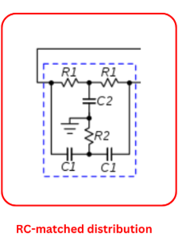
MODULE 2
Clock-Distribution Techniques
Routed RC Tree Clock Distribution
RC-matched distribution is a clock distribution technique where the electrical delay (RC delay) of clock paths is matched instead of matching their physical lengths.
It is mainly used in irregular chip layouts where symmetric structures like H-trees cannot be implemented easily.
Equivalent RC Model
Clock path can be represented using an RC network:
R1, R2 → resistance of clock interconnect wires
C1 → load capacitance from registers or logic gates
C2 → capacitance of interconnect wires
These components model the real electrical behavior of the clock network.

Slide 41
MODULE 2
Clock-Distribution Techniques
Routed RC Tree Clock Distribution
Designers adjust:
wire length
wire width
buffer size
load distribution
so that each clock path has similar RC delay.
Even if two paths have different physical lengths, they can still have the same delay if their RC values match.
In RC-matched clock distribution, we do not try to make all wires the same length. Instead, we ensure that the electrical delay (R×C delay) of each path is the same so that the clock arrives at all registers at nearly the same time.

Slide 42
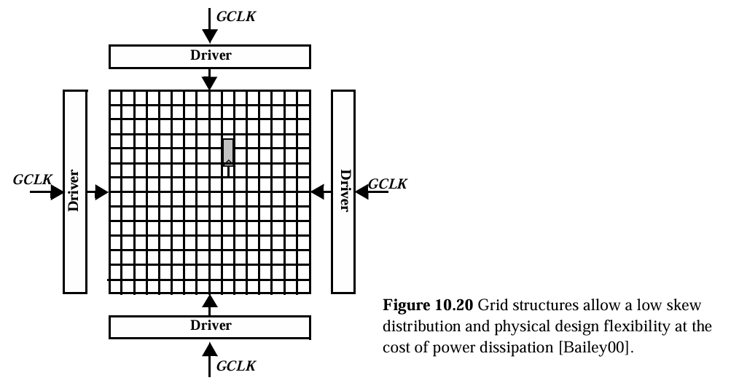
MODULE 2
Clock-Distribution Techniques
Grid Clock Distribution
In this approach, the clock is distributed using a grid or mesh network.
Multiple drivers feed the clock into the grid.
Working
Global clock driver sends clock signals.
Clock enters the grid network.
The grid distributes the clock to all registers.
Advantages
Very low clock skew
Clock can be accessed from many points
Flexible for late design changes
Disadvantages
Very high power consumption
Large number of wires
Because of this, grids are usually used in the final stage of clock distribution.
A grid clock distribution spreads the clock through a mesh of wires across the chip so that multiple paths deliver the clock to each register, reducing clock skew.

Slide 43
MODULE 4
Latch-Based Clocking
Latch-Based Clocking and Slack Borrowing
Introduction
In synchronous digital systems, combinational logic blocks are separated by storage elements to ensure correct sequencing of data. Traditionally, edge-triggered flip-flops are used for this purpose.
However, an alternative approach uses level-sensitive latches instead of flip-flops. This technique is called latch-based clocking.
The main advantage of latch-based clocking is that it allows timing flexibility between pipeline stages, enabling slack borrowing, which improves system performance.

Slide 44
MODULE 2
Latch-Based Clocking
Pipelining
In synchronous digital circuits, we divide a large combinational circuit into multiple smaller stages. Between these stages we place storage elements like registers.
These storage elements ensure that:
• data moves stage by stage • each stage works within one clock cycle • overall system works synchronously
Traditionally we use edge-triggered flip-flops for this purpose.

Slide 45
MODULE 2
Latch-Based Clocking
Behavior of Edge-Triggered Flip-Flops
An edge-triggered flip-flop captures data only at a clock transition.
For example, in a positive edge flip-flop:
• data is sampled only at the rising edge of the clock • after that edge, the flip-flop output remains constant until the next edge
So the combinational logic between two registers must complete its operation within one clock period.
The timing requirement becomes:
Clock period ≥ clock-to-Q delay + combinational logic delay + setup time.
This means the slowest stage in the pipeline determines the clock frequency.

Slide 46
MODULE 2
Latch-Based Clocking
Limitation of Edge-Triggered Pipelines
Now consider two stages of combinational logic.
Suppose:
Stage A delay = 40 ns Stage B delay = 80 ns
Since stage B takes longer, the clock period must be at least 80 ns.
But stage A finishes its computation in 40 ns.
However, the result of stage A cannot move forward until the next clock edge.
So the remaining 40 ns of time is wasted.
This unused time is called slack.
In edge-triggered pipelines this slack cannot be used by other stages.
As a result, some stages finish early and remain idle while waiting for the next clock edge.
This reduces the overall efficiency of the pipeline.

Slide 47
MODULE 2
Latch-Based Clocking
Motivation for Latch-Based Clocking
To overcome this limitation, designers sometimes replace flip-flops with level-sensitive latches.
The key difference is that a latch does not operate only at an edge.
Instead, a latch is transparent during one level of the clock.
For example, a positive level latch behaves like this:
When the clock is high, the latch is transparent and the output follows the input.
When the clock becomes low, the latch closes and stores the last value.
Because of this behavior, data can propagate during the time when the latch is transparent, not just at a single instant.
This property provides timing flexibility.

Slide 48
MODULE 2
Latch-Based Clocking
Two-Phase Latch Based Pipeline
In latch-based designs we typically use two sets of latches controlled by two clock phases.
These clocks are usually called:
CLK1 CLK2
They operate alternately.
When CLK1 is active, the first set of latches becomes transparent.
When CLK2 is active, the second set of latches becomes transparent.
Thus the pipeline stages are arranged as alternating latches.
The data flows from a latch controlled by CLK1 to logic, then to a latch controlled by CLK2, and then to the next logic stage.

Slide 49
MODULE 2
Latch-Based Clocking
How Computation Happens
Let us follow the timing conceptually.
When the first latch becomes transparent, the input data passes through it and enters the first logic block.
After the latch closes, the logic block continues computing.
When the next clock phase activates, the second latch becomes transparent and captures the output of the logic block.
Immediately the next stage of logic can start computing.
Thus computation moves from one stage to the next based on clock phases instead of clock edges.

Slide 50
MODULE 2
Latch-Based Clocking
Slack Borrowing
The most important advantage of latch-based pipelines is slack borrowing.
Slack borrowing means a pipeline stage can use unused time from a neighboring stage.
To understand this concept, imagine two consecutive logic stages.
Suppose each stage ideally should take half of the clock cycle.
However, in practice one stage might take longer while the other stage might take less time.
Because latches are transparent during part of the clock cycle, the slower stage can continue computing slightly longer than its nominal time.
Meanwhile the next stage can start computing slightly later.
Effectively, the slower stage has borrowed time from the next stage.
Thus the timing slack is redistributed across stages instead of being wasted.

Slide 51
MODULE 2
Latch-Based Clocking
Why Slack Borrowing is Possible
Slack borrowing is possible because of the level-sensitive behavior of latches.
Since a latch remains transparent for a certain duration of the clock phase, data does not need to wait for a specific clock edge to propagate.
If a stage finishes early, the next stage can start earlier.
If a stage finishes slightly late, the next stage can still capture the result during the transparent period.
Therefore the exact timing boundary between stages becomes more flexible.

Slide 52
MODULE 2
Latch-Based Clocking
Maximum Borrowable Time
There is still a limit to how much time can be borrowed.
In a two-phase latch system, the maximum time that one stage can borrow from the next stage is approximately half of the clock period.
This is because each latch is transparent only during its active clock phase.
If the delay becomes larger than this limit, the data might arrive too late to be captured by the next latch.
Therefore proper timing analysis is required to ensure correct operation.

Slide 53
MODULE 2
Latch-Based Clocking
Disadvantages
Despite the advantages, latch-based clocking also introduces some challenges.
Clock design becomes more complex because two non-overlapping clock phases must be generated.
There is also a possibility of race conditions if clock phases overlap.
The timing analysis is more complicated compared to flip-flop based pipelines.
Because of these difficulties, many modern designs prefer flip-flop pipelines unless the performance gain from latches is significant.

Slide 54
MODULE 2
Latch-Based Clocking
Time Sharing in Latch Pipelines
Flip-Flop Pipeline (Edge Triggered)
Execution
Stage A computation
Start time = 0 ns Finish time = 3 ns
But the next flip-flop captures data only at 10 ns.
So Stage B can start only at 10 ns.
Stage A remains idle from 3 ns to 10 ns.
Unused time:
5 ns − 3 ns = 2 ns slack
But Stage B cannot use this slack.
Given
Clock period Tclk = 10 ns
Two pipeline stages:
Stage A delay = 3 ns Stage B delay = 7 ns
Total logic delay:
3 ns + 7 ns = 10 ns
Operation
• Data moves only at clock edges • Each stage must finish before the next clock edge
If the clock period is 10 ns, the pipeline stages are effectively divided:
Stage A → 5 ns Stage B → 5 ns
Result
Stage B needs 7 ns, but only 5 ns is available.
Therefore the pipeline fails timing.
Even though total delay is 10 ns, the rigid stage boundaries prevent sharing of time.

Slide 55
MODULE 2
Latch-Based Clocking
Latch Pipeline (Level Sensitive)
Execution
Stage A computation
Start time = 0 ns Finish time = 3 ns
Since the next latch is transparent during that phase, the result passes immediately.
Stage B starts computing at 3 ns.
Stage B delay = 7 ns
Finish time:
3 ns + 7 ns = 10 n
Operation
• Latches are transparent during a clock phase • Data can propagate through a latch whenever it arrives during that window
This means stages are not strictly divided.
What Happened?
Result
The total computation finishes exactly at the end of the clock period.
So the circuit works correctly.
Originally each stage had 5 ns.
Stage A used 3 ns, leaving 2 ns unused.
Stage B needed 7 ns, which is 2 ns more than its allocation.
Stage B borrowed the unused 2 ns from Stage A.
This is called Slack Borrowing.

Slide 56
MODULE 4
Self-Timed Circuit Design
Why Do We Need Self-Timed Circuits?
Most digital circuits today use a synchronous design approach.
In synchronous systems:
• All operations are controlled by a global clock • Every register changes state only on a clock edge • Data moves through pipeline stages at every clock cycle
The clock therefore controls when computations start and when results are captured

Slide 57
MODULE 4
Self-Timed Circuit Design
Two Important Roles of the Clock
In synchronous circuits the clock has two major responsibilities.
1. Physical Timing Control
The clock ensures that all logic operations have enough time to complete.
The clock period must be larger than the worst-case delay of the pipeline stage.
Mathematically:
Tclk>max⁡(tpd1,tpd2,tpd3)+tregT
​ Where
• tpdt = propagation delay of logic blocks • treg​ = register delay
This ensures that all signals settle before the next clock edge.
2. Logical Ordering of Events
The clock also acts as a global coordinator.
At every clock edge:
• new inputs are sampled • computations start • registers update
So the clock determines when each operation happens.

Slide 58
MODULE 4
Self-Timed Circuit Design
Advantages of Synchronous Design
Synchronous design is widely used because it is:
• Structured and predictable • Easy to design and analyze • Deterministic behavior • Supported by many CAD tools
However, it also has some limitations.

Slide 59
MODULE 4
Self-Timed Circuit Design
Problems with Synchronous Systems
1. Clock Skew and Jitter
The clock must reach all parts of the circuit at the same time.
In reality this is difficult because of:
• clock skew • clock jitter
These effects cause timing uncertainty
2. Large Current Spikes
When the clock edge arrives:
• thousands of registers switch simultaneously
This causes:
• large current spikes • power supply noise • electromagnetic interference
3. Performance Limited by Worst Case Delay
In synchronous systems the clock period must accommodate the slowest possible path.
Even if most operations are faster, the clock must wait for the worst case.
Example:
A 16-bit adder may take different times depending on the data.
But the clock must assume the longest delay.
Thus the system often runs slower than necessary

Slide 60
MODULE 4
Self-Timed Circuit Design
Asynchronous Design Idea
To overcome these problems, designers can remove the global clock.
This approach is called asynchronous design.
In asynchronous circuits:
• operations start as soon as data is available • circuits do not wait for a clock edge • the timing is determined by signal propagation
However designing fully asynchronous circuits is difficult because:
• race conditions may occur • timing analysis becomes complex

Slide 61
MODULE 4
Self-Timed Circuit Design
Self-Timed Circuits (Practical Asynchronous Approach)
A more practical solution is self-timed circuits.
Self-timed circuits do not use a global clock but still maintain correct ordering of operations.
The key idea is:
Each logic block signals when it has finished computation.
So instead of waiting for a clock, the next stage starts when the previous stage completes.

Slide 62
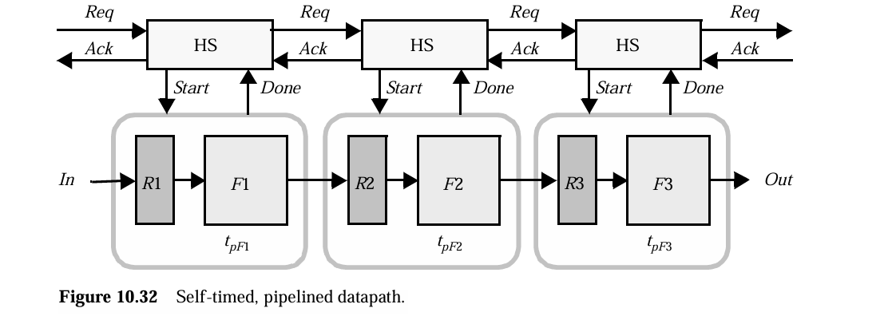
MODULE 4
Self-Timed Circuit Design
Completion Detection
Each combinational block generates a signal called:
Done
When the computation finishes.
Process:
A Start signal activates the logic block.
The block performs computation.
When finished, it raises a Done signal.
This indicates that the result is ready.
Handshaking Mechanism
To coordinate stages, self-timed circuits use a handshaking protocol.
Two signals are used:
Request (Req) Acknowledge (Ack)
This mechanism ensures proper communication between blocks.

Slide 63
MODULE 4
Self-Timed Circuit Design
How the Handshake Works
Key Idea of Self-Timed Circuits
The sequence of operation is:
Step 1: Request
When input data arrives, a Request signal is sent to the next block.
This indicates that new data is available.
In synchronous systems:
Logical ordering and timing are both controlled by the clock.
In self-timed circuits:
These two functions are separated.
• Done signal ensures correct physical timing • Req/Ack signals ensure logical ordering
Thus operations occur when computation finishes, not when the clock ticks.
Step 2: Start Computation
The logic block begins processing the input.
Step 3: Completion Signal
After computation finishes, the block generates a Done signal.
Step 4: Acknowledge
The receiving block sends an Acknowledge signal.
This means it has received the data and is ready for the next input.

Slide 64
MODULE 4
Self-Timed Circuit Design
Advantages of Self-Timed Circuits
3. Power Efficiency
Blocks that are not active automatically remain idle.
This saves power.
Also the power overhead of clock distribution is removed.
1. No Global Clock Distribution
Clock networks are eliminated.
This avoids:
• clock skew • clock distribution power
4. Robust to Variations
Self-timed circuits adapt automatically to:
• temperature variations • supply voltage changes • manufacturing variations
Performance depends on actual operating conditions.
2. Higher Performance
Operations proceed at the actual speed of hardware, not the worst case.
Example:
Ripple carry adder
Worst case delay = O(N)
Average delay ≈ O(log N)
Self-timed circuits operate closer to the average delay.
Disadvantages
These benefits come with some cost.
Self-timed circuits require:
• additional control logic • completion detection circuits • handshaking hardware
This increases area and design complexity.

Slide 65
MODULE 4
Clock Synthesis and Synchronization Using a Phase-Locked Loop
Digital systems need a clock signal.
• The clock controls all operations • Higher performance → higher clock frequency needed
But:
👉 Crystal oscillators (external source) give only limited frequency 👉 Modern processors need much higher frequency
So we need a circuit that:
✔ generates high-frequency clock ✔ keeps it accurate and stable ✔ aligns clocks between systems
That circuit is called:
PLL (Phase-Locked Loop)
Why Do We Need a PLL?
A PLL is a feedback system that:
👉 compares two signals 👉 adjusts one of them 👉 until both are phase aligned
A PLL is a feedback circuit that locks the phase and frequency of an output signal to a reference signal.

Slide 66
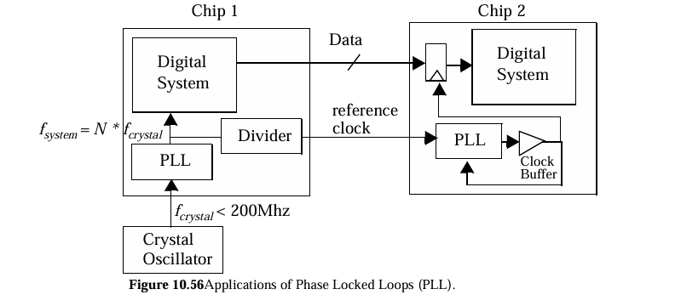

MODULE 4
Clock Synthesis and Synchronization Using a Phase-Locked Loop
Frequency Multiplication
Converts
low-frequency clock → high-frequency clock
Key Functions
• Clock generation • Frequency multiplication • Synchronization

Slide 67
MODULE 4
Clock Synthesis and Synchronization Using a Phase-Locked Loop
PLL in Chip-to-Chip Synchronization
In digital communication between two chips, data is transmitted along with a reference clock from the transmitting chip to the receiving chip.
However, due to transmission delays and clock buffering in the receiving chip, misalignment can occur between the data and the clock signal, a problem known as clock skew.
This misalignment can lead to incorrect sampling of data and system errors.
To solve this issue, a PLL is used in the receiving chip to synchronize the clock with the incoming data.
The PLL compares the incoming reference clock with the locally generated clock and adjusts its phase and frequency to align them.
This process, known as de-skewing, ensures that the clock edges are properly aligned with the data, enabling reliable and accurate data sampling in high-speed communication systems.

Slide 68
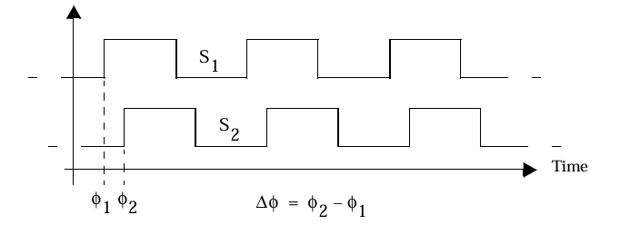
MODULE 4
Clock Synthesis and Synchronization Using a Phase-Locked Loop
Basic Concept of Phase in PLL
Periodic signals of the same frequency can be completely described using their phase relationship.
When two signals have identical frequencies, the important parameter is not just the frequency but the relative phase difference between them.
If one signal is shifted in time with respect to another, this shift is represented as a phase difference (Δφ).
In a PLL system, this phase difference is continuously measured and corrected.
The fundamental goal of a PLL is to adjust its output signal such that the phase difference between the reference signal and the generated signal becomes constant (ideally zero).
Thus, PLL operation is based on aligning two periodic signals in time by controlling their phase relationship.

Slide 69
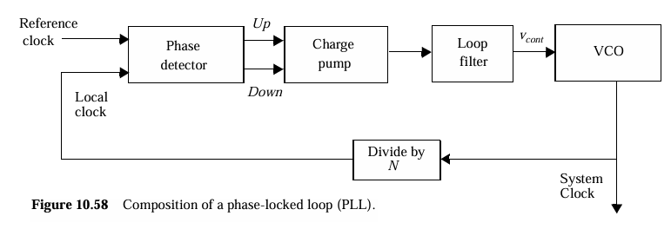
MODULE 4
Clock Synthesis and Synchronization Using a Phase-Locked Loop
PLL Block Diagram

Slide 70
MODULE 4
Clock Synthesis and Synchronization Using a Phase-Locked Loop
Phase Detector
Charge Pump
The phase detector compares:
Reference clock
Feedback clock (from output)
Now imagine two signals:
If reference arrives earlier → system is slow
If feedback arrives earlier → system is fast
So phase detector produces:
UP signal → speed up
DOWN signal → slow down
The phase detector gives digital signals:
UP or DOWN
But VCO needs analog voltage.
So charge pump converts:
UP → increase voltage
DOWN → decrease voltage
Charge pump converts timing error → voltage signal

Slide 71



MODULE 4
Clock Synthesis and Synchronization Using a Phase-Locked Loop
Loop Filter
VCO
If we directly send charge pump output to VCO:
Voltage will fluctuate rapidly
Output clock becomes unstable
Jitter increases
So we use a loop filter.
A Voltage Controlled Oscillator (VCO) is a circuit that generates a periodic signal (clock) whose frequency depends on an input voltage.
Removes high-frequency noise
Smooths voltage
Makes system stable
PLL is a feedback system
Too fast correction → unstable Too slow correction → slow response
Loop filter balances this.

Slide 72
MODULE 4
Clock Synthesis and Synchronization Using a Phase-Locked Loop

Slide 73
MODULE 4
Clock Synthesis and Synchronization Using a Phase-Locked Loop

Slide 74
MODULE 4
Clock Synthesis and Synchronization Using a Phase-Locked Loop

Slide 75
MODULE 4
Clock Synthesis and Synchronization Using a Phase-Locked Loop

Slide 76

MODULE 1 MOS TRANSISTOR AND PROCESSING TECHNOLOGY

